Slide 1
Model diagnostics for linear models
Beware the Monkey’s Paw

Slide 2


The Monkey’s Paw
Models will (almost) always answer your question
No guarantee that just because you got an answer, that it’s a “good” answer
How do we protect ourselves from producing *scientifically peer-reviewed* misinformation?
How do you make sure you don’t get fired?

Slide 3

Assumptions
All models have assumptions
Assumptions are things we hope are true, such that we can do the analysis we want to do and interpret them
Some of these we can check
Some we cannot
  “Assumption of validity” cannot be checked
  I.e. is my data even suitable for answering my question?

Slide 4
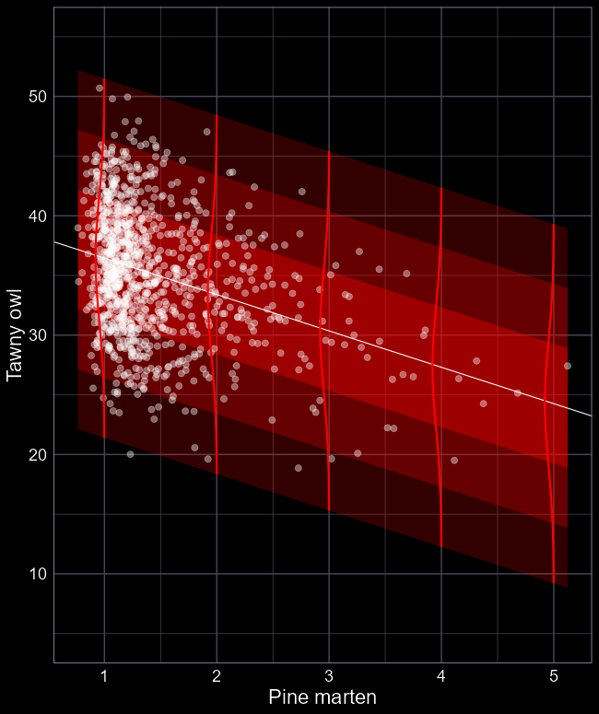
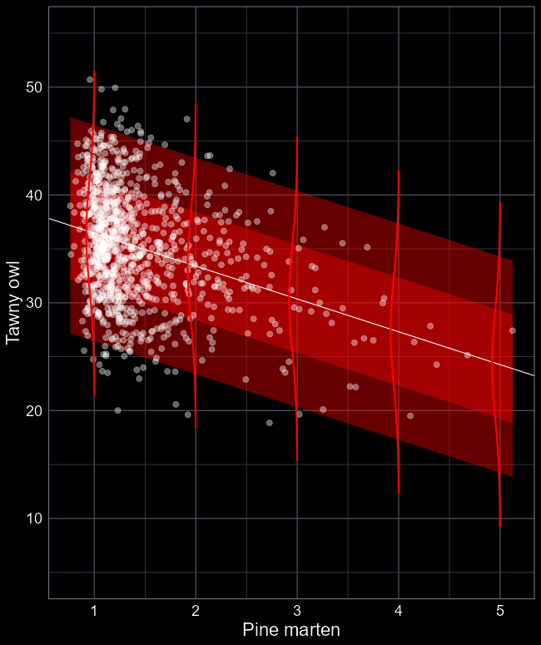
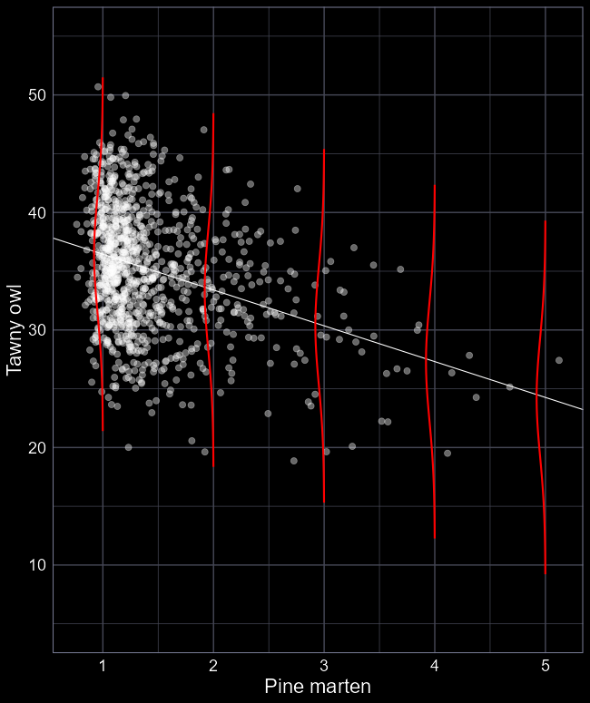
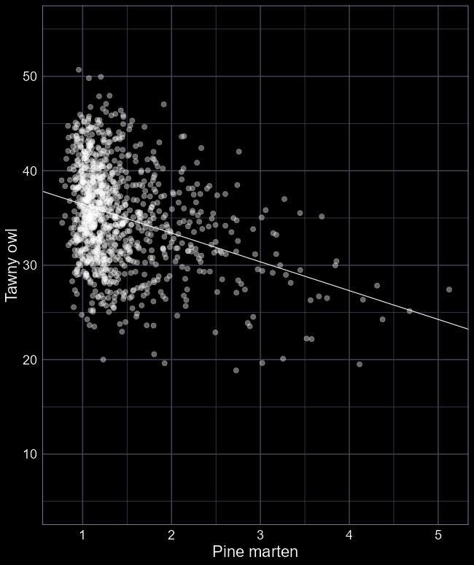
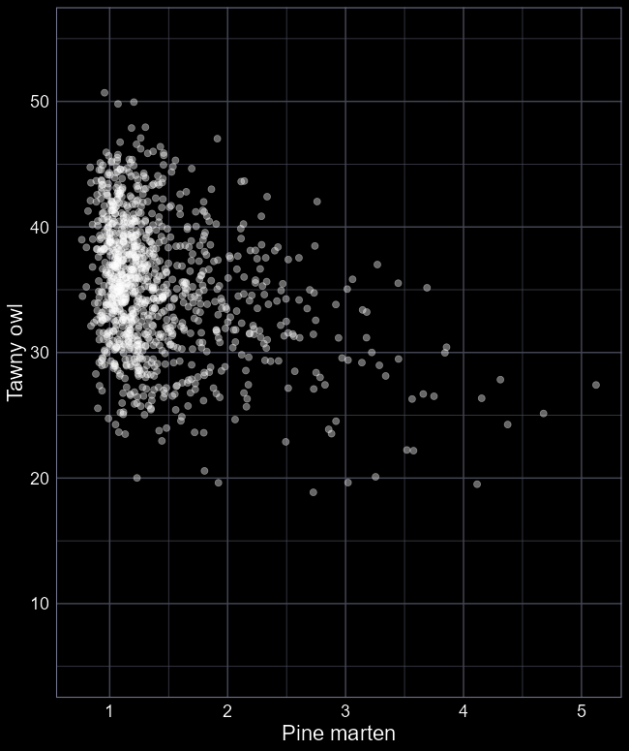
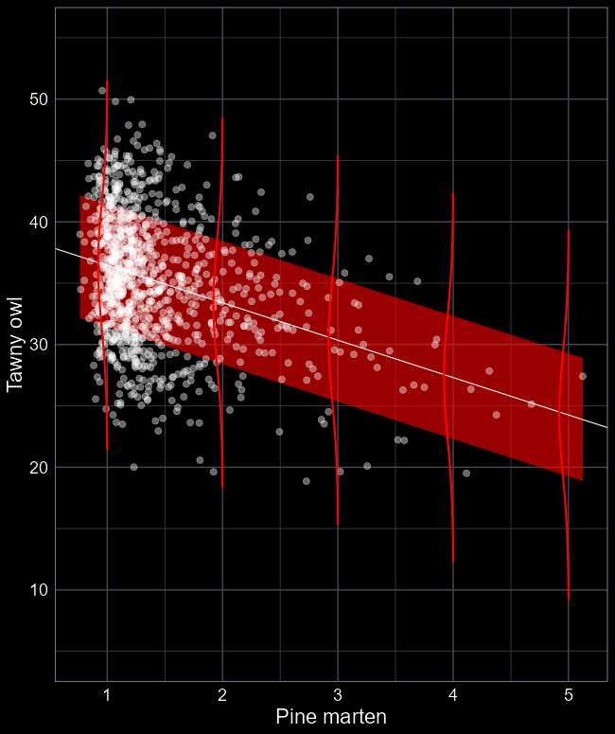
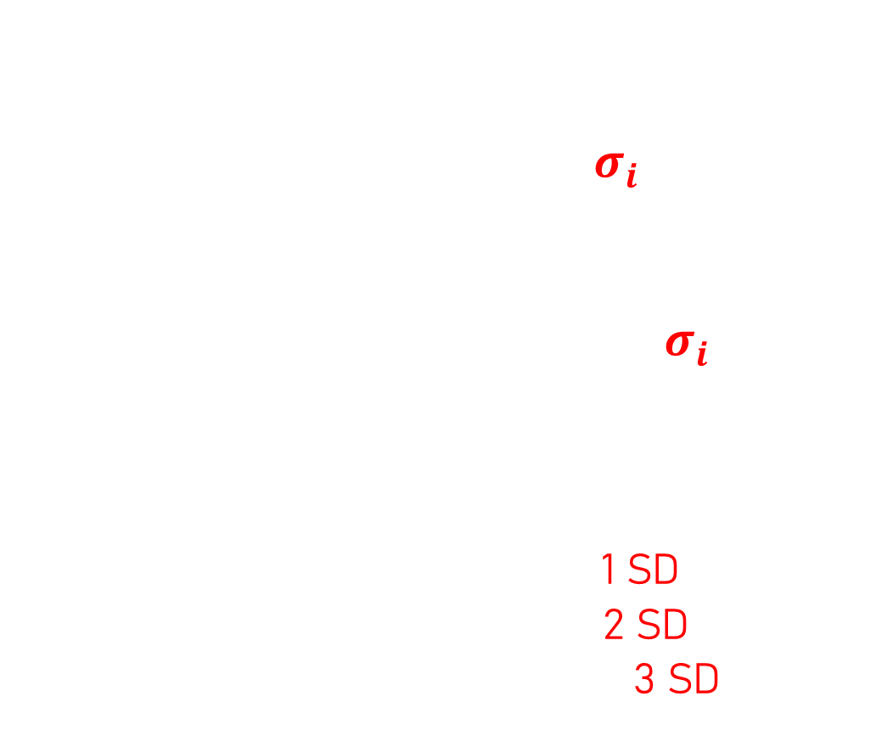

Assumption of $Normality$
Given we’ve fit a model that assumes a $Normal$ distribution
$$y_{i}∼Normal(μ_{i}, σ_{i})$$
$$μ_{i}=β_{0}+β_{1}×Marten_{i}$$
We assume our residuals should be normally distributed, given $σ_{i}$
Meaning:
  Observations should lie within the estimate standard deviation (SD)
  Ca. 69% should be within 1 SD
  Ca. 95% should be within 2 SD
  Ca. 97.5% should be within 3 SD

Slide 5
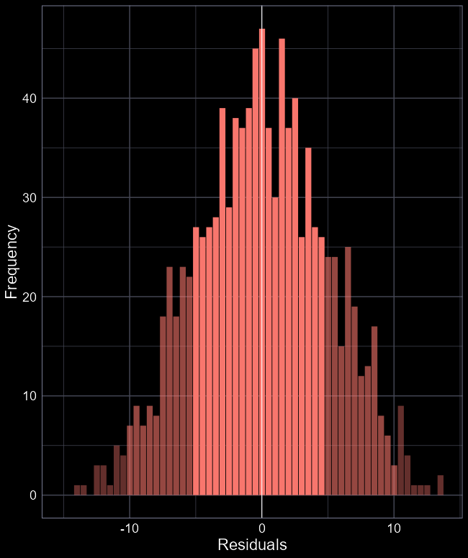
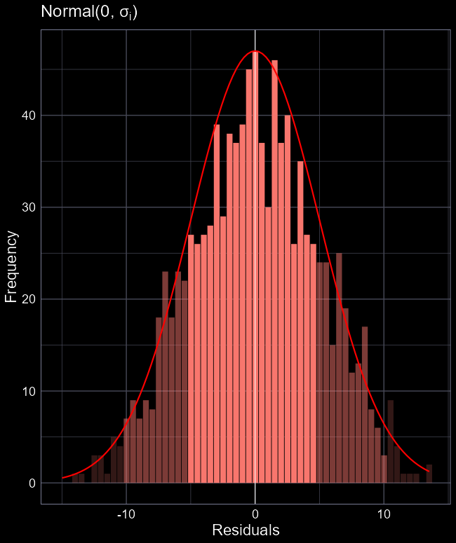
Work smarter, not harder
Are our residuals normally distributed?
Hard to say from this figure, and this is a pretty simple example
Is there a better way to evaluate our assumption?

Slide 6
Make life easier
Making this figure is very fiddly
R has existing methods to make this easier for you
And also offer more ways to diagnose your model

Slide 7
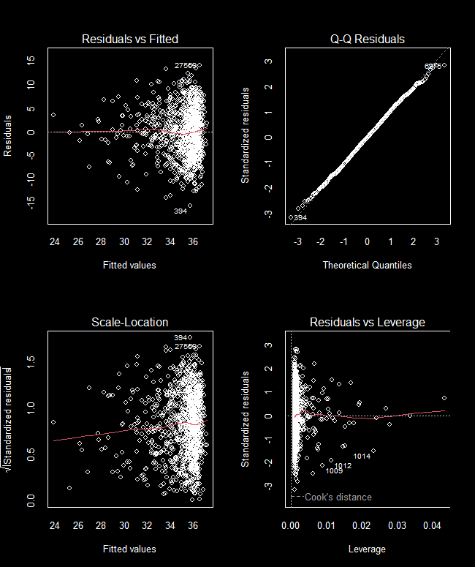
The four horseman
plot(owl_model)
Returns four conventional diagnostic plots to check how well your model 1) meets assumptions and 2) how well it “performs”
These are pretty subjective and require experience to gauge
We’ll go through them slowly

Slide 8
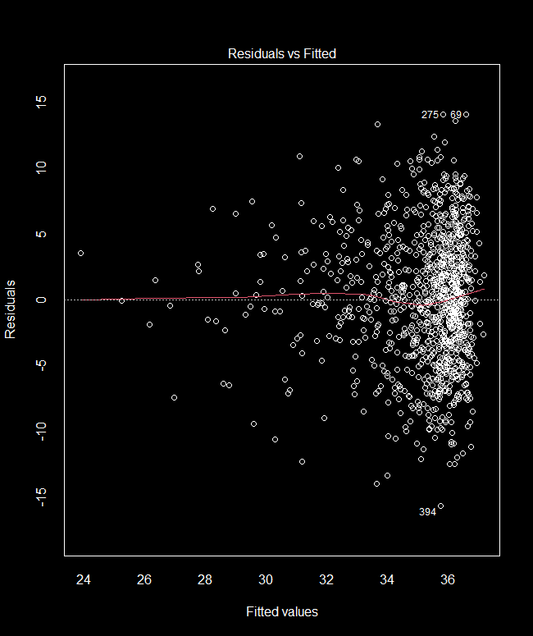
Residuals vs Fitted
Orientation:
  Y-axis: Residuals (difference between actual observation and the predicted value)
    For this model, actual number of tawny owls minus the number of tawny owls the models thinks there should be
  X-axis: Predicted (“Fitted”) values
  Dashed line at 0 residual is when our model perfectly predicts an observation
  Red line is a moving average
27.0 predicted owls
19.5 actual owls
-7.5 residual error

Slide 9
Residuals vs Fitted
What we want to see:
No clear pattern in residuals
  As we move left to right, points are evenly spread on y-axis
Red line roughly on 0 residual
  But don’t take too seriously

Slide 10
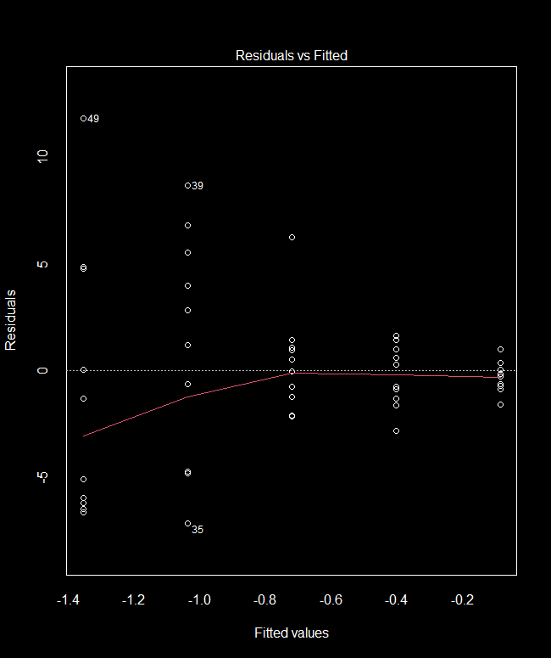
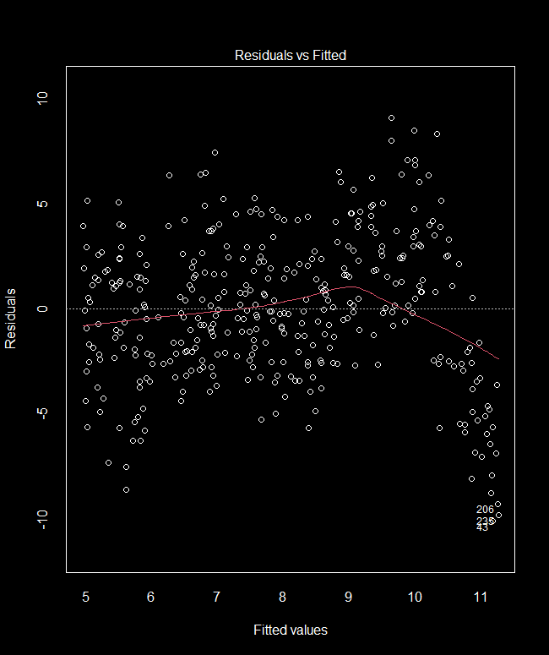
Residuals vs Fitted
Allows us to check 2 assumptions:
Heteroscedasticity
  Stupid word meaning:
  “Unequal variation across predicted values”
Linearity
  We assume the relationship is linear
If broken:
  Can cause issues with uncertainty (SE)
  Can bias parameter estimates
Causes:
  Relationship is not linear
  More/less variation as predicted values get higher or lower

Slide 11
Residuals vs Fitted
We seem to have a funnel pattern
  Should we be worried?
  We don’t have lots of data with low tawny owl density, so hard to get even spread
Limited data in this range, so
hard to say if funnel shape is real
or consequence of limited data.
Limited data in this range, so
hard to say if funnel shape is real
or consequence of limited data.

Slide 12
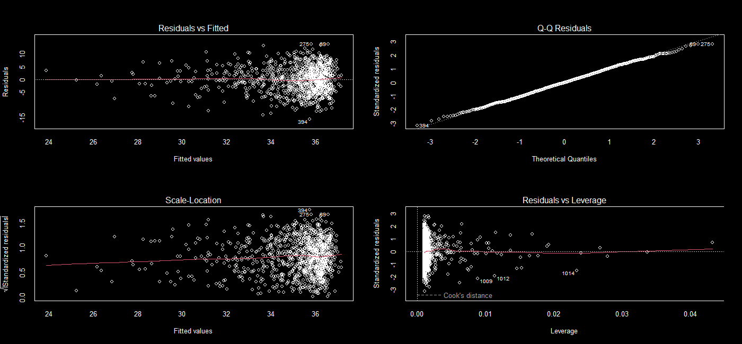
The four horseman
Possibly ok but not conclusive

Slide 13
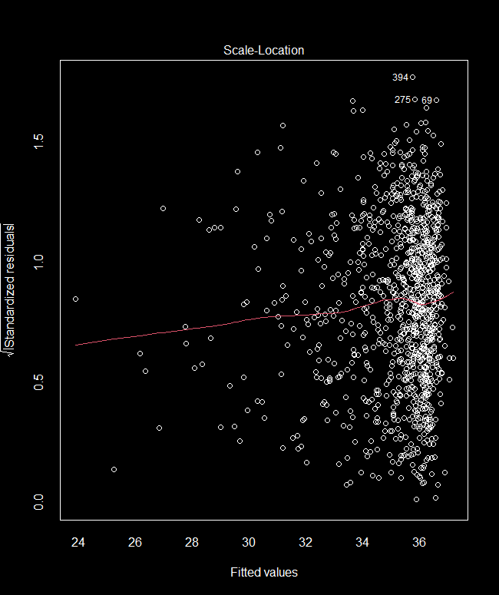
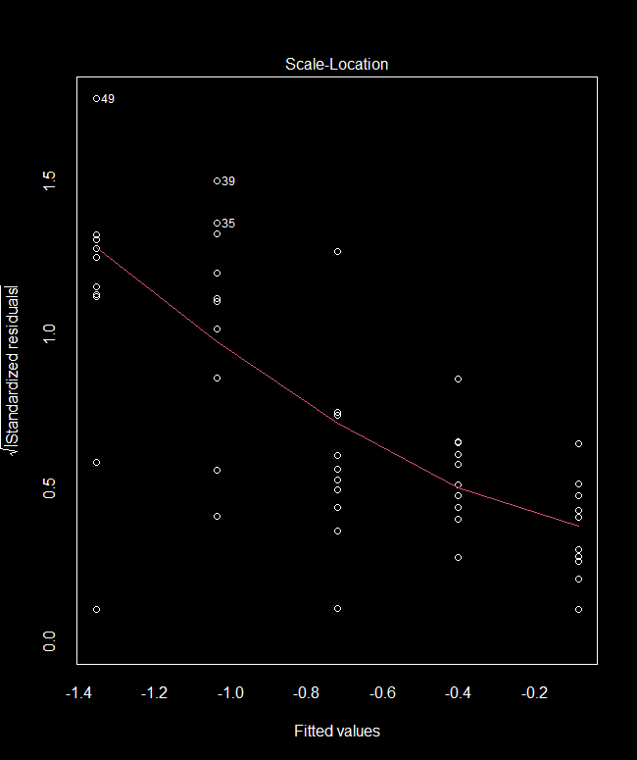

Scale-Location
Residuals (y-axis) are now:
  Standardised (divide by $σ$)
  Square rooted (all values are positive)
We want to see two things here:
  Ca. 95% of Std. Residuals are < 2
  No clear patterns
Offers another chance to check heteroscedasticity

Slide 14
The four horseman
Possibly ok but not conclusive
Probably good enough

Slide 15
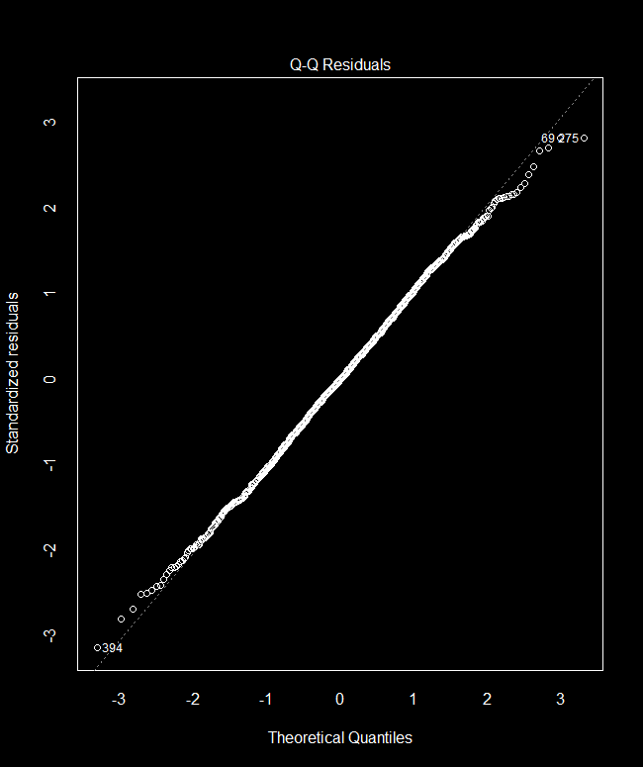


Q-Q Residuals
Assumed $Normal$ distribution
We assume our residuals are $Normally$ distributed
The Q-Q (Quantile-Quantile) Residuals plot allows us to check
Y-axis are standardised residuals
  To 1 standard deviation
X-axis are what we would assume, given $Normal(0, σ)$
If $Normally$ distributed, then points should mostly lie on the dashed line

Slide 16
The four horseman
Possibly ok but not conclusive
Excellent
Probably good enough

Slide 17
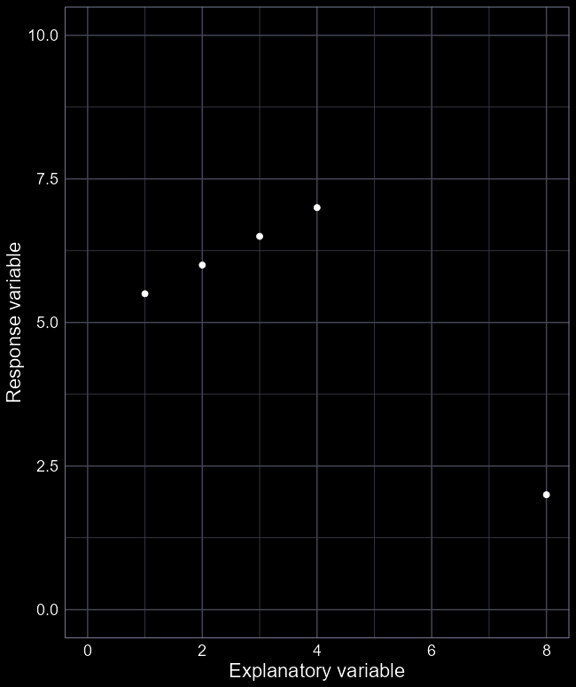
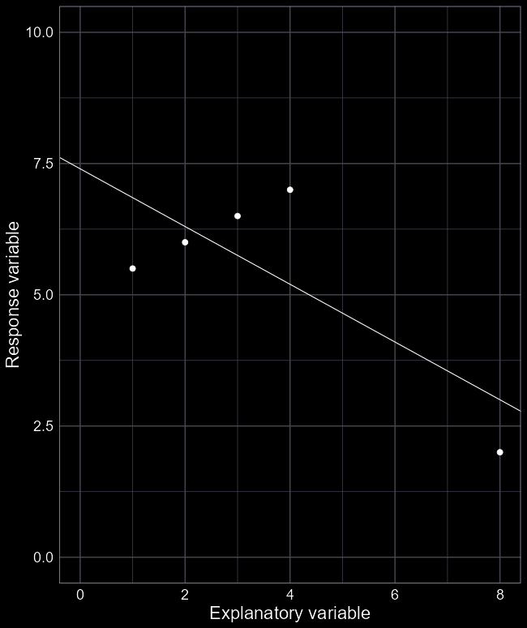
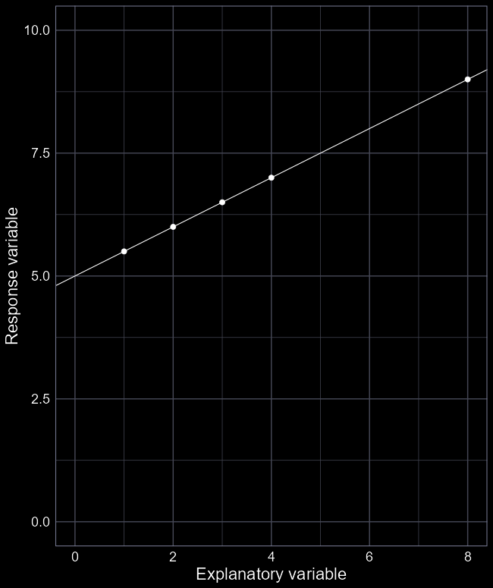

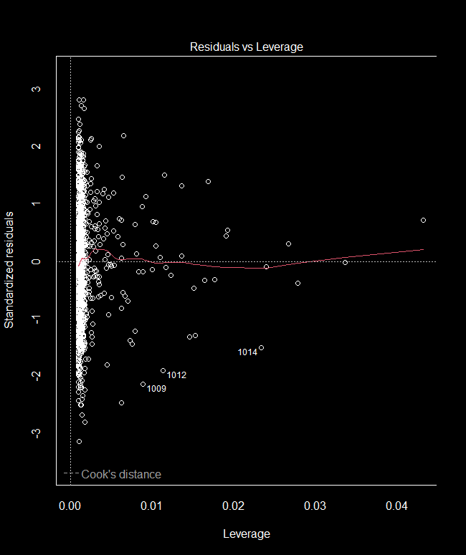

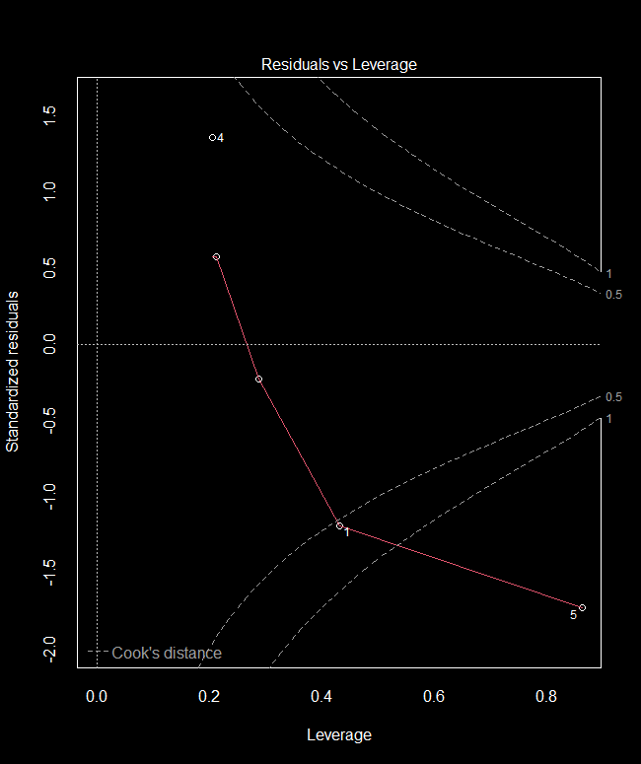

Residuals vs Leverage
High Leverage
Low Influence
Y-axis is standardised residuals
X-axis is “Leverage”
  Leverage identifies observations “far” from the rest of the explanatory variable
The Leverage plot helps identify if you have highly influential observations
But high Leverage $≠$ Influential
High Cook’s Distance $=$ Influential
New data point “far” away from other values
Entire relationship changes to accommodate one observation
New data point “far” away from other values
High Leverage
High Influence

Slide 18
The four horseman
Possibly ok but not conclusive
Excellent
Probably good enough
Excellent

Slide 19
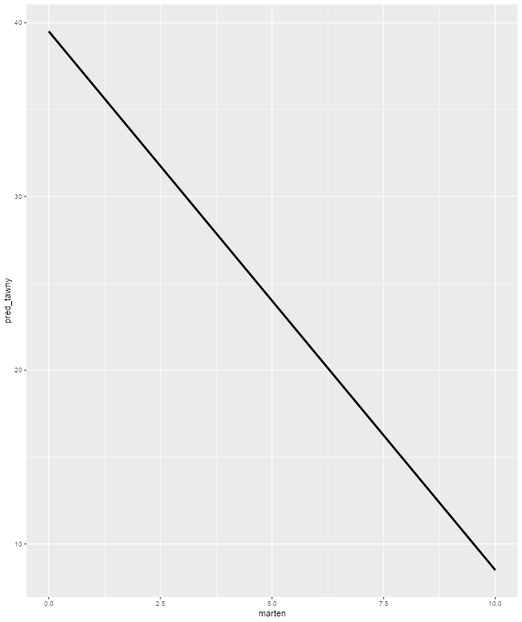
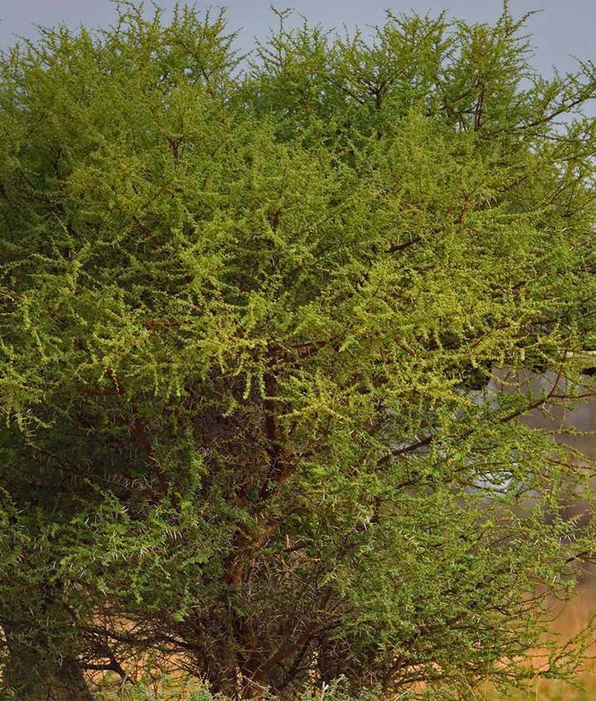
Satisfied?
We’ve checked our model, and there’s nothing that suggests we’ve broken any of our assumptions (that we can check)
So can we interpret our model with complete confidence?

Slide 20

Hidden assumptions
The data we used were densities of two species
  Counting animals is difficult
  Estimating density is really difficult
  Doing this for two species is really, really difficult
Lots of reasons why densities of both animals will be underestimated, in different ways!
  In truth, we don’t know how many animals there are in these sites, we have guesses

Slide 21
Satisfied?
So can we interpret our model with complete confidence?
To answer this, you have to think exceptionally carefully about the data, as well as the stats

Slide 22
Linear models with continuous variable: Full workflow example

Slide 23

Climate change
Is climate change a scam?
Let’s find out:
  Sea surface temperature (response)
  CO2 emissions (explanatory)

Slide 24
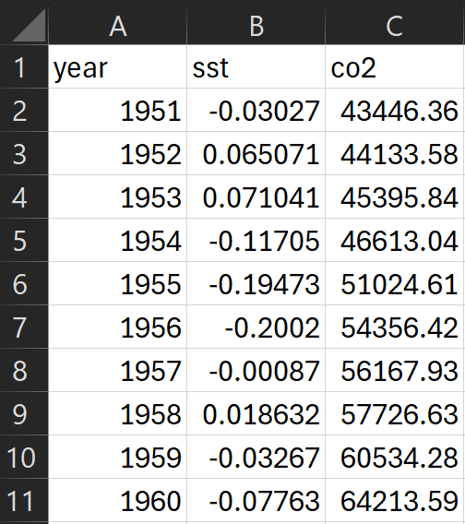
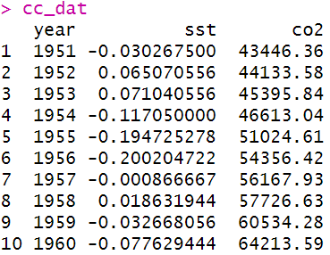

Step 1: Get data
Ensure data is in tabular form
Each row represents a data collected from a given year ($i$)
  The “$i^{th}$ year”
Each year, we have a measure of:
  Average sea surface temperature
  CO2 emissions (millions of tonnes)
cc_dat <- read.csv(“file_path”,
header = TRUE)

Slide 25
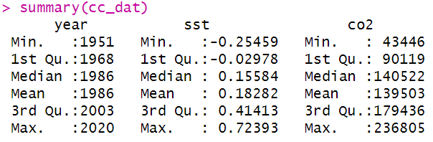
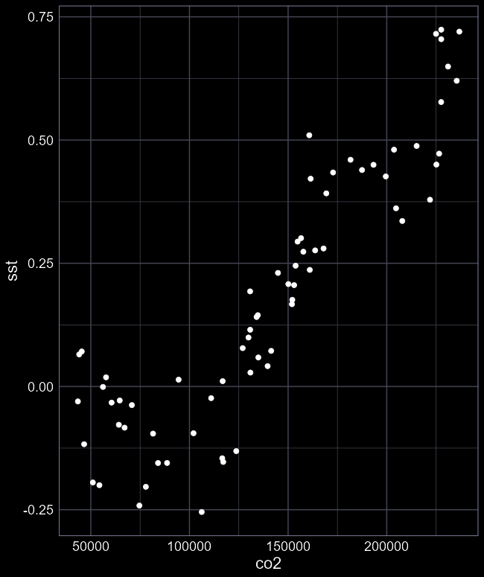
Step 2: Explore data
Explore the data
summary(cc_dat)
ggplot(cc_dat) +
geom_point(
aes(x = co2,
y = sst))
What should we think about?
  How reliable is the sampling?
  How much of the relationship do we see?
  Foresee any issues for the analysis?

Slide 26

Step 3: Fit model
Unless we see any issues, we can proceed to fitting a linear model
cc_mod <- lm(sst ~ co2,
data = cc_dat)
Easiest step to do
But appreciate what’s going on under the hood

Slide 27
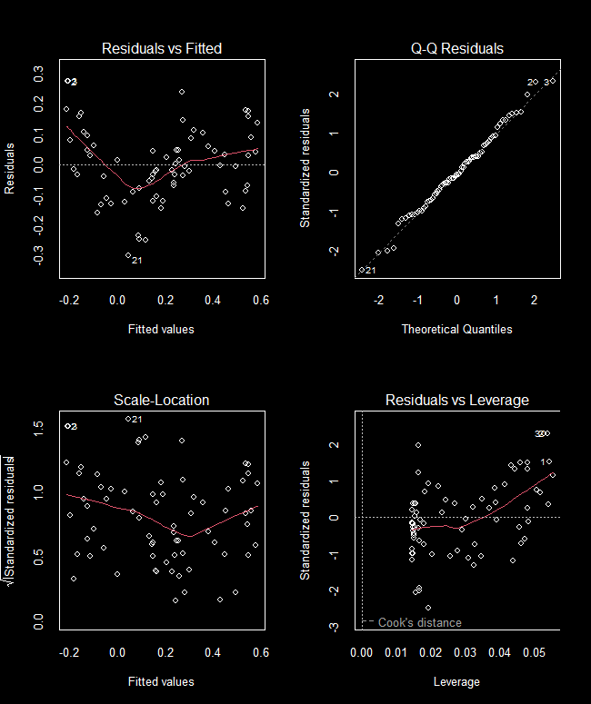
Step 4: Diagnose
With model run, we need to check for the Monkey’s Paw
Check diagnostics
Any issues?
  Some clear non-linearity
  What do we learn from the relationship being non-linear?
  Can we still proceed?

Slide 28

Step 5: Summarise
The model has two parameters to estimate
  $β_{0}$ and $β_{1}$
summary(cc_mod)
  $β_{0}=−0.3913$ (SST with zero CO2)
  $β_{1}=0.000004$ (Celsius per mill tonne)
Any caveats?
> summary(cc_mod)
Call:
lm(formula = sst ~ co2, data = dat)
Residuals:
Min 1Q Median 3Q Max
-0.300407 -0.083491 -0.006237 0.077314 0.275486
Coefficients:
Estimate Std. Error t value Pr(>|t|)
(Intercept) -3.913e-01 3.845e-02 -10.18 2.67e-15 ***
co2 4.115e-06 2.548e-07 16.15 < 2e-16 ***
---
Signif. codes: 0 ‘***’ 0.001 ‘**’ 0.01 ‘*’ 0.05 ‘.’ 0.1 ‘ ’ 1
Residual standard error: 0.1227 on 68 degrees of freedom
Multiple R-squared: 0.7932, Adjusted R-squared: 0.7902
F-statistic: 260.9 on 1 and 68 DF, p-value: < 2.2e-16

Slide 29
Step 6: Plot predictions
With model fit, we can now show the full predicted relationship
Generate fake values of explanatory variable
Apply our equation to get predicted sst
Plot
(We’ll cover 95% CI in next week’s lecture)

Slide 30
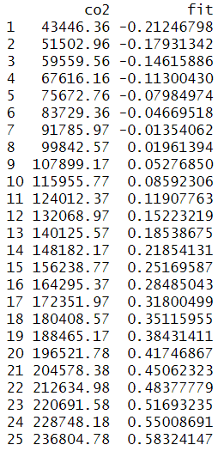
Step 6: Plot predictions
With model fit, we can now show the full predicted relationship
Generate fake values of explanatory variable
fake <- data.frame(
co2 = seq(from = min(cc_dat$co2),
to = max(cc_dat$co2),
length.out = 25))
fake$fit <- predict(cc_mod,
newdata = fake)

Slide 31
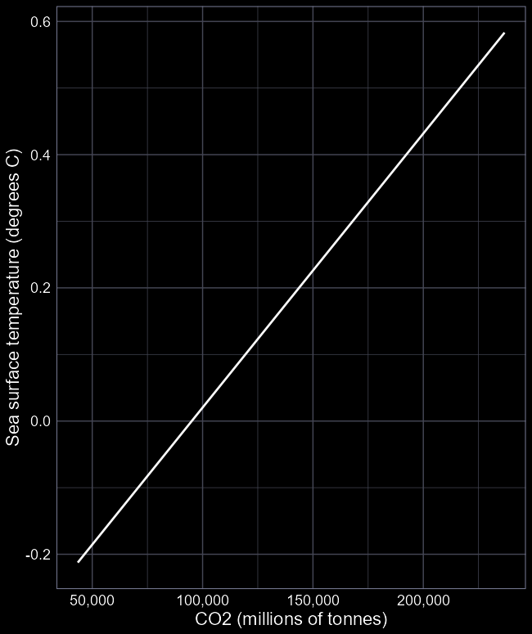
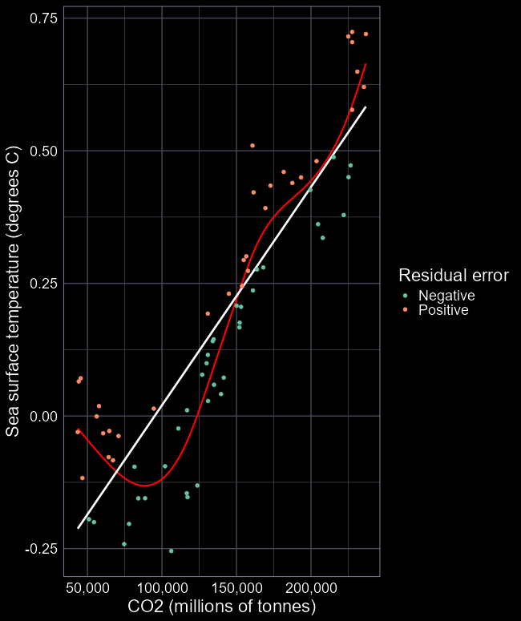
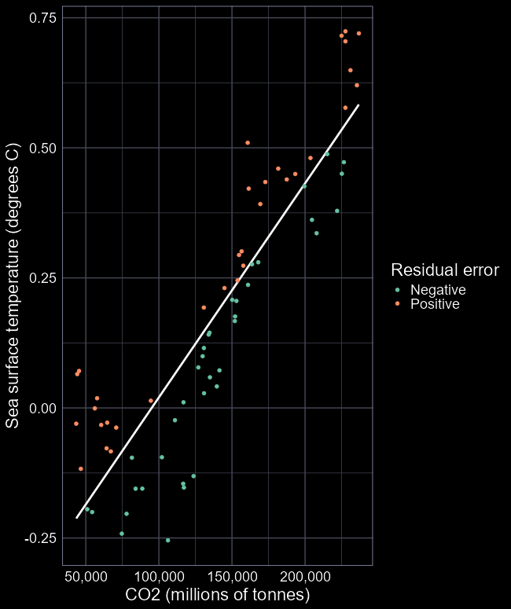
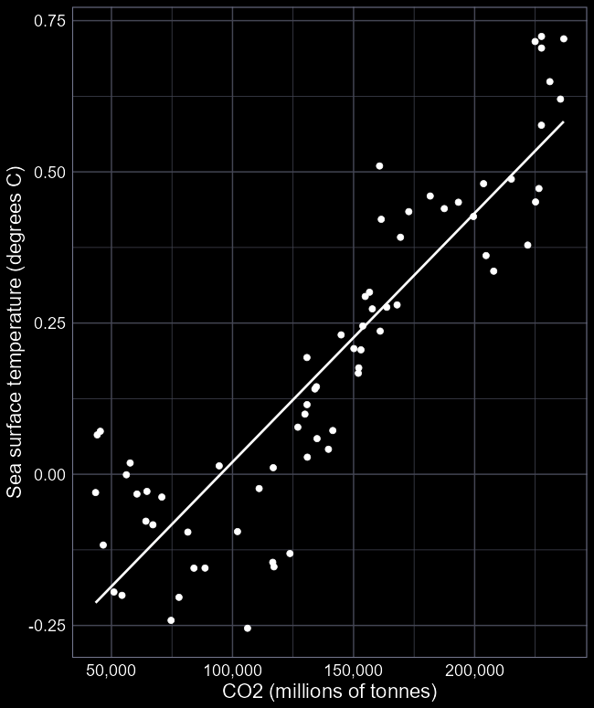
Step 6: Plot predictions
With model fit, we can now show the full predicted relationship
ggplot(fake) +
geom_line(aes(
x = co2,
y = fit))
Add the actual data
… +
geom_point(data = cc_dat,
aes(x = co2,
y = sst))

Slide 32

Step 7: Discuss
Is climate change a scam?
How conclusive is our evidence?
  Are there any alternative ways to interpret the results?
What additional assumptions do we make if we believe CC is real?
  Is the data suitable for answering our question?
Are those assumptions fair?

Slide 33
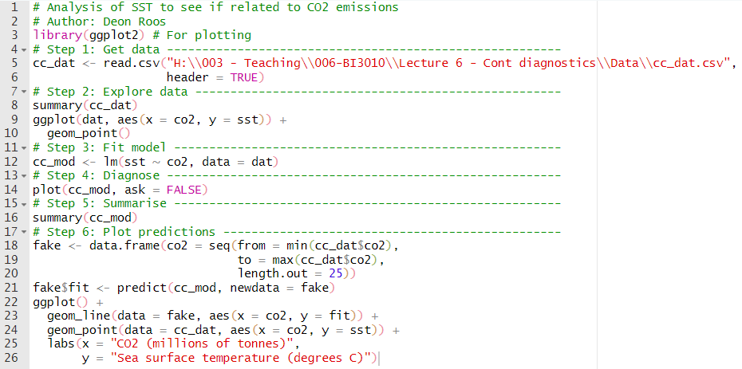
tl;dr
Complete analysis in 26 lines of code

